Slide 1


Banking Data Analysis & Term Deposit Prediction
Sandeep Yelikatte
April 2025
by sandeep goud

Slide 2
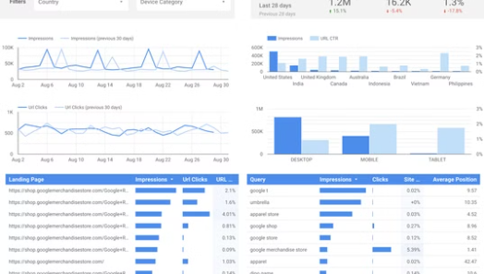


Introduction: The Importance of Analytics in Banking
Overview of Project
Importance of Analyzing Banking Data
Predicting Customer Behavior
Targeted Marketing Campaigns

Slide 3
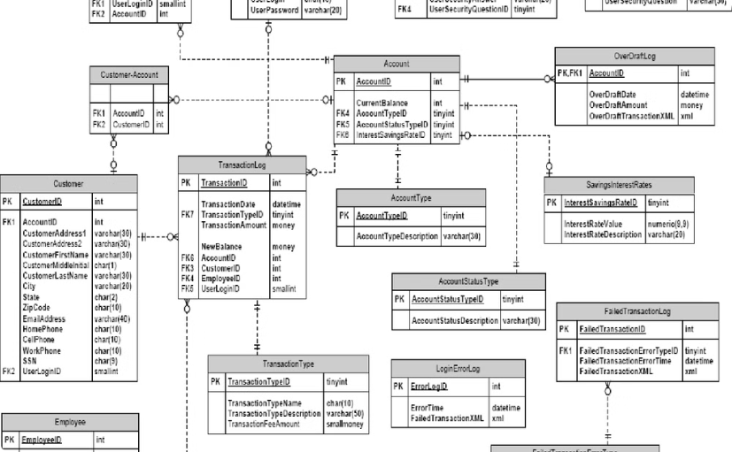
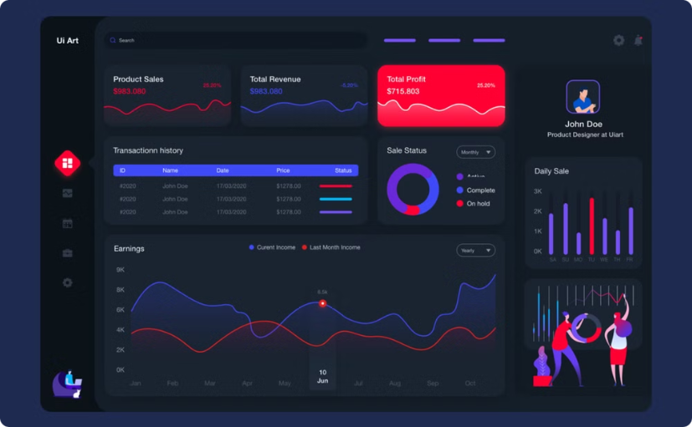
Project Overview: Goals and Data Sources
Banking Data
Project Goals
Customer Demographics, Transaction History, Account Information
Exploratory Data Analysis, Predictive Model Building, Business Insights

Slide 4
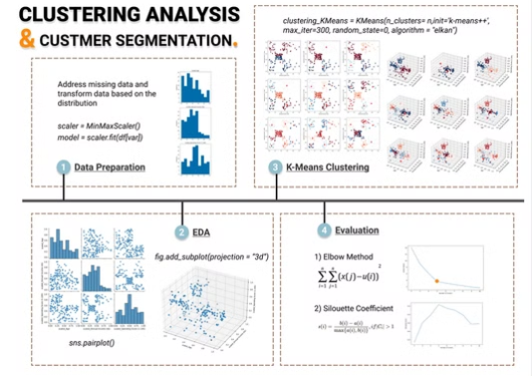
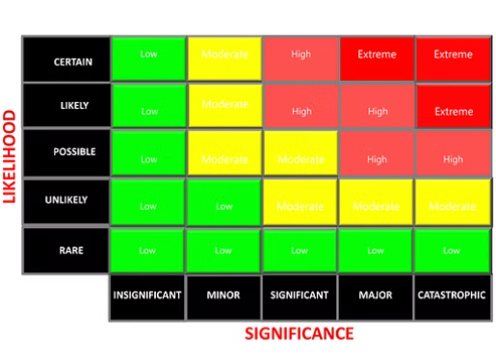
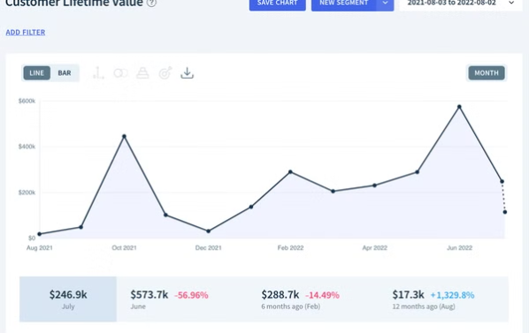
Exploratory Data Analysis: Key Findings
Customer Segmentation Insights
Risk Assessment Visualization
Key Drivers of Term Deposit Subscriptions

Slide 5
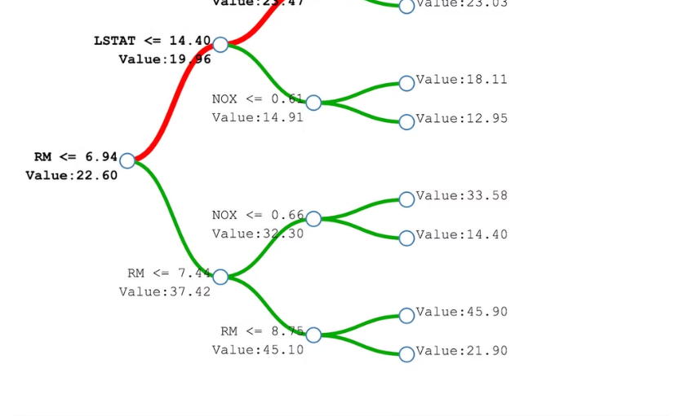
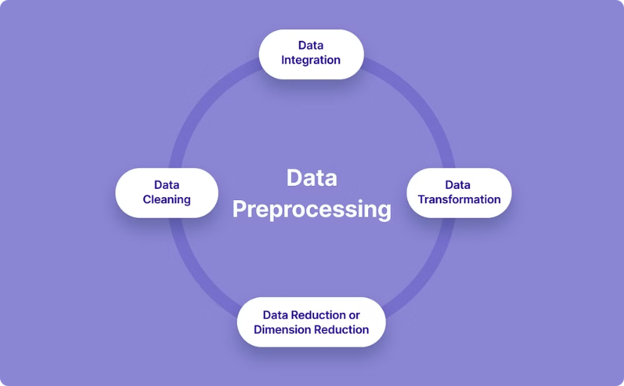
Methodology: Random Forest Classification Model
Feature Selection
Data Pre-processing
Identifying key variables influencing predictions.
Cleaning, Transforming, and Preparing Data

Slide 6
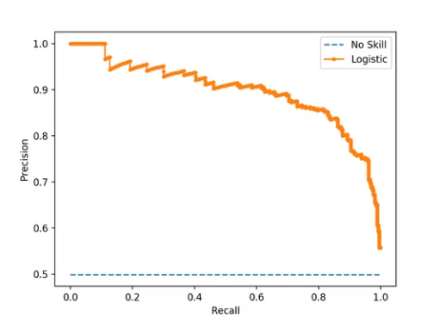
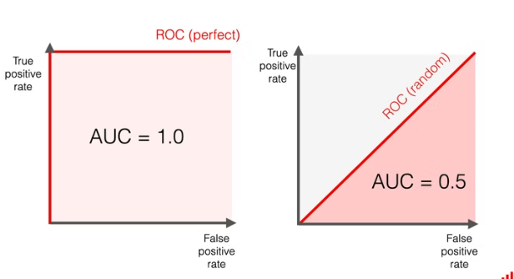
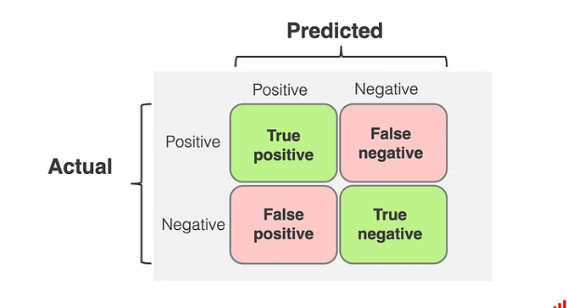
Model Performance
Accuracy, Precision, and Recall Scores
Model Validation and Generalization

Slide 7
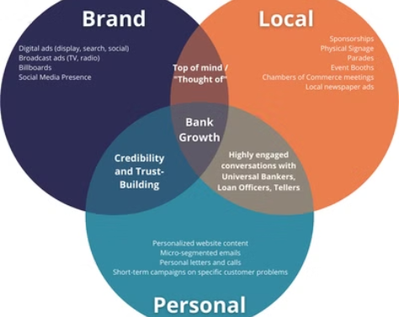

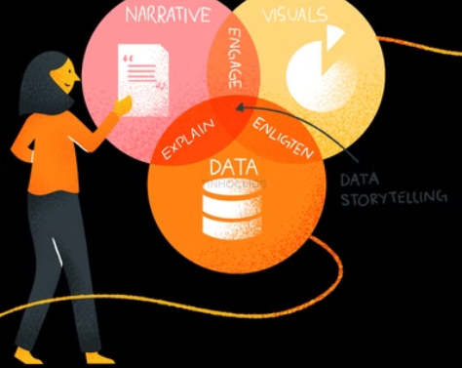
Key Insights and Business Implications
Optimizing Marketing Campaign Targeting
Improving Customer Retention Strategies

Slide 8
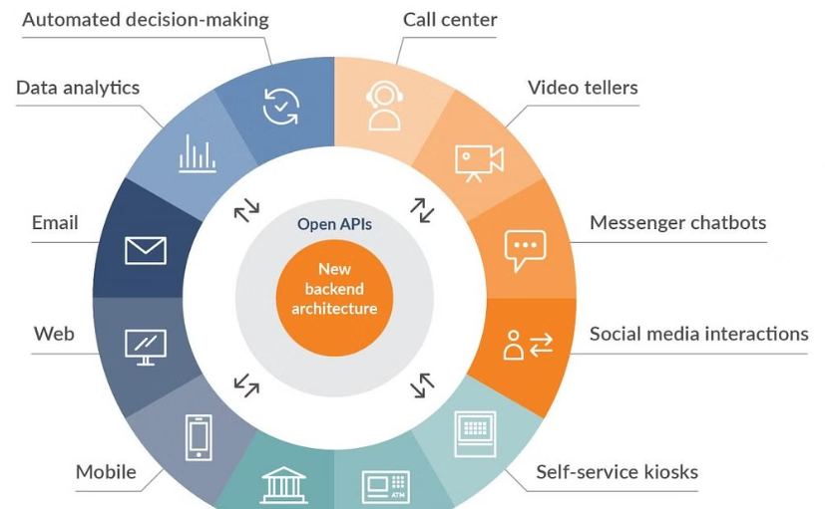

Conclusion and Next Steps
Future Enhancements
Next Steps
More sophisticated Models, Data sources.
Implementation, Ongoing Monitoring

